Slide 1
超越学科界限的认知基础 Transdisciplinary Cognitive Foundation 复杂系统: 从数学、 物理、生物、到社会 第三周
顾学雍
九月二十九日

Slide 2
超越学科界限的认知基础 Transdisciplinary Cognitive Foundation Complex Systems: from biology to math, physic, and society Week 3
Ben Koo
September 29, 2021

Slide 3

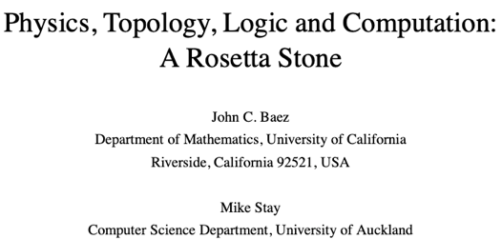
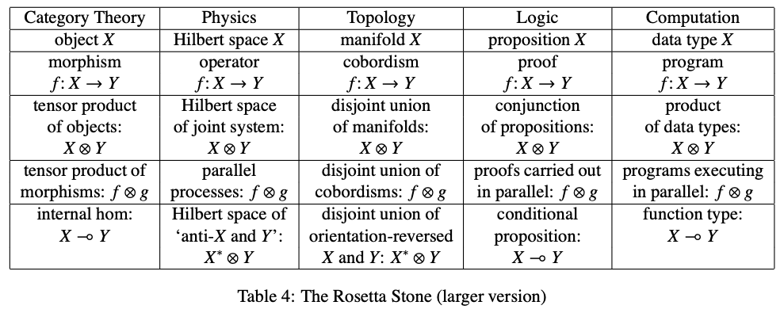
The Rosetta Stone by John Baez
(namespaces)
Image source: wikipedia

Slide 4
The Rosetta Stone of Scientific Language
Biology | Math | Physics | Cybernetics/System Sciences
Homeostasis/DNA | Iterative/Recursive Functions | Multi-Scale Interactions | Feedback Loops
Cellular Construction/Boundary Setting | Difference/Differentiation | Observations | Data Collection
Lifespan Expansion | Integration | Spacetime Accumulation | Statistical Interpretation
Entropy Negation | Numbers/Generative Name Spaces/Algebras | “Unified” Theory | From Theory to Applications and Back

Slide 5

Please just WATCH, while asking yourself the following question: Why matter rarely stay in liquid form, compared to solids and gases?
A National Geographic Film of life form animated in 6 minutes.

Slide 6
Glossary
Terms related to Biology, Math, Physics, Society (Complex Systems):
Homeostasis/体内平衡: a steady state maintained by living system. (Wikipedia)
Closed Loop/Feedback Loop: a recursive structure that feed information back to itself.
Complex Systems : Systems that exhibit properties, such as spontaneous order, homeostasis, feedback
Complex System related Ideas:
Cybernetics: The Theory and Practice of Control and Communication.
System properties: Correctness = Liveness * Safety, Trust-worthy Data

Slide 7
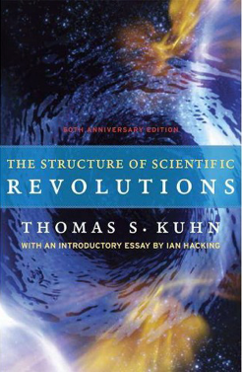

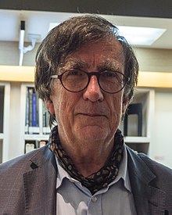
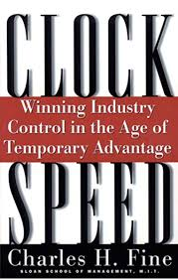

Science as an Evolutionary Process for NsM
Huawei VP Mr. Yang Shaoqing
Emerging cases or
systematic attacks
Normal Science
Model
Drift
Model Crisis
Model Revolution
Paradigm
Change
Prof. Bruno Latour
RICH 70 Tsinghua SEA Cloud Forum, Sep 14, 2020
H. E. Bambang Brodjonegoro,
Minister of Research & Technology, Indonesia

Slide 8
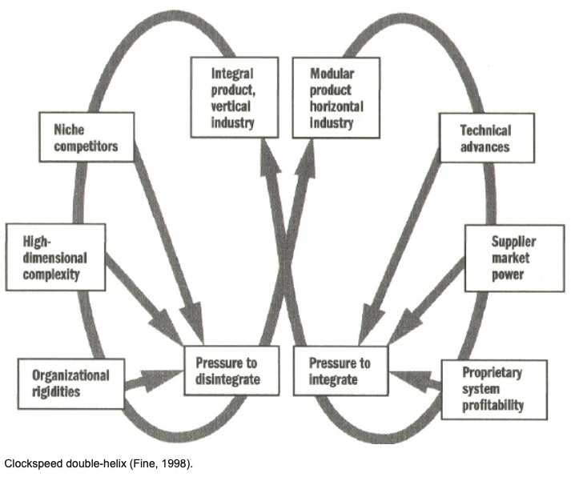
Updating Name Space to witness shared Time

Slide 9
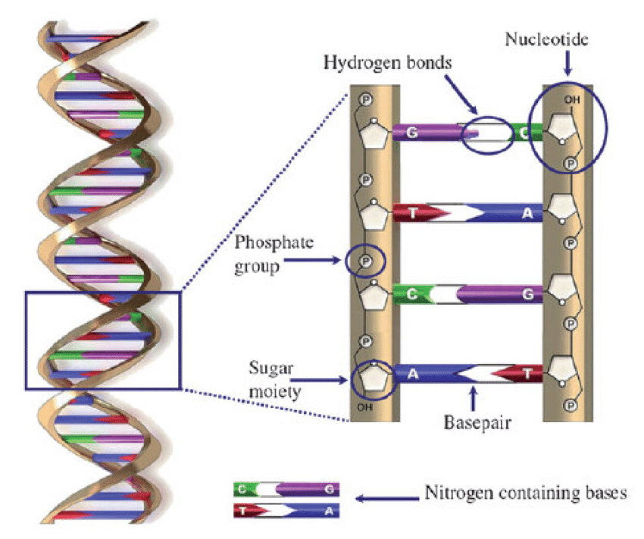
Double Helix and Life Forms
What is interesting about Double Helix?
It is a simple structure that has Iteration and Branching!
(Iterations relates to time, and Branching Relates to Space)
The complexity of the structure
determines the updating clockspeed.
Image Source: Salieb-Beugelaar

Slide 10
The Notion of Universal Operators
All Name Spaces can be generated through Algebraic Operators
Add, Subtract, Multiply, Divide
Product (Multiply and Divide)
Splitting and multiplication.
Co-Product (Add and Subtract)
Joining and summation
Exponential Objects

Slide 11
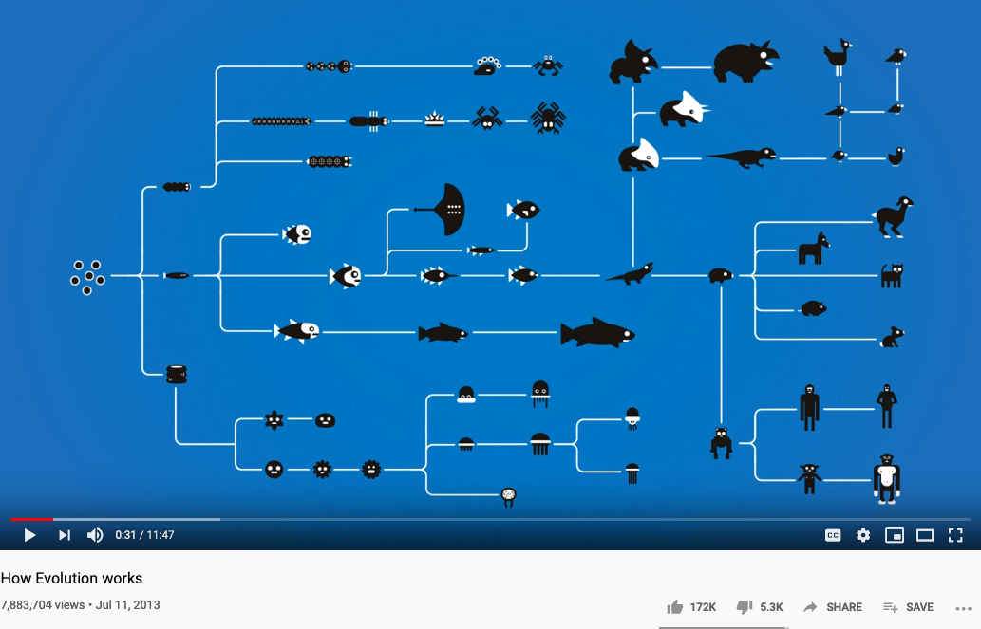
Biological Iterations and Branching

Slide 12
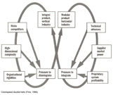

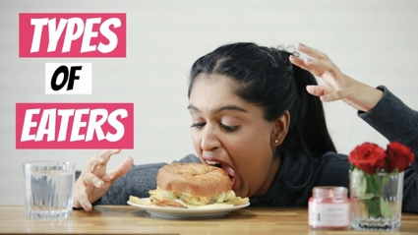
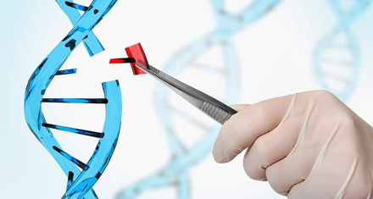
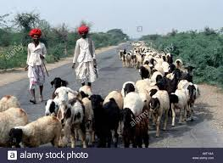
Updating Name Space to across time scales
Traders/Hunters
（students/teachers）
Miners/Herders
（Administrators/Witnesses）
Coders/DNA Editors
(Artists/Creative People)
Consumers/
Distributors
Sec
Dev
Ops
Content Producers/
Product Designers
Accountants/
Notary Service Providers

Slide 13
Time and Trust-worthiness in NsM
All Name Spaces should share a universal “clock”
The common “Historical-Trail” (time-based) of Name Spaces
So that the time-stamps would offer hints to cross-check “causal” consistency
Name Spaces should be extensible
It should follow one consistent naming convention for easy referencing
Kuhn’s Cycle provides a Generative/Cyclic Model
Name Space Authentication should be scalable and distributed
Existing mechanisms for authenticated name registration, i.e. Domain Name Services (DNS).

Slide 14
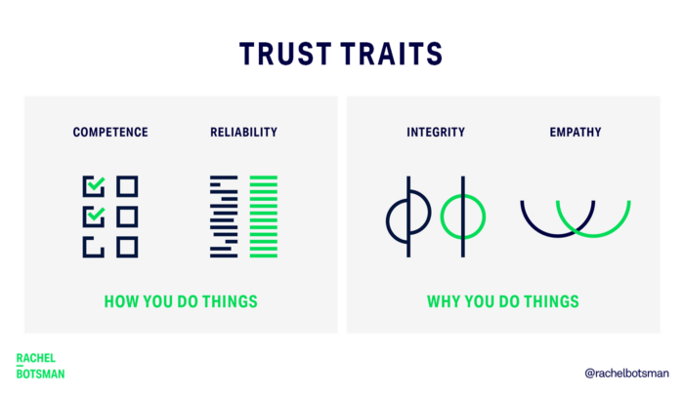
Trust-worthy Name Space?
Competence:
What can you deliver?
Reliability:
Success rate of delivery?
Integirty:
Will you ever cheat me?
Empathy:
Are you on my side?
Being More Trustworthy: The Basics
― Rachel Botsman, Jan 14, 2019

Slide 15
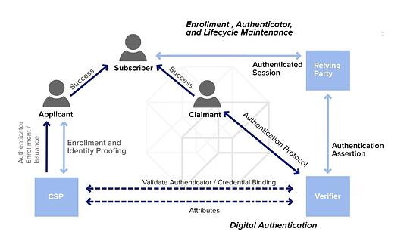
Authenticated Name Space?
Digital Authentication - the basics
― Dawn M. Turner (guest) on 01. August 2016

Slide 16
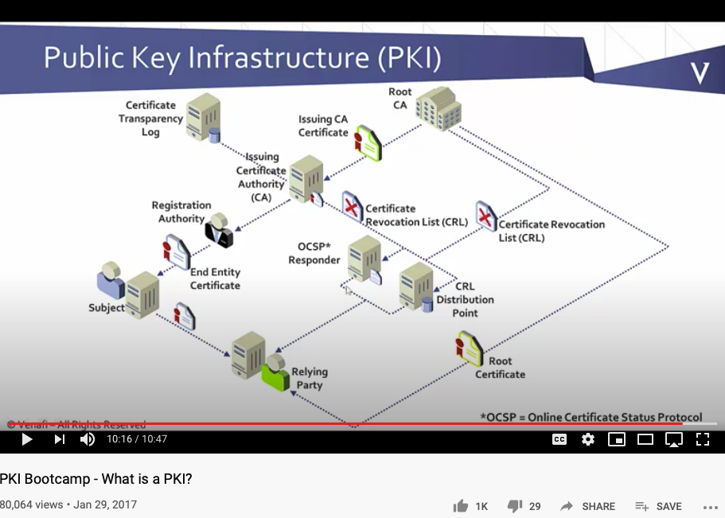
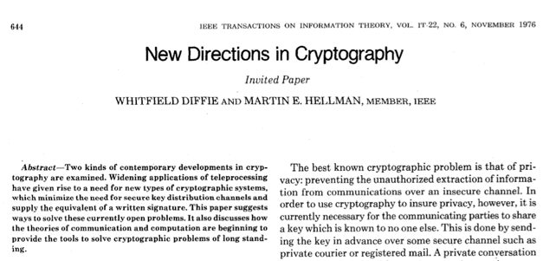
Public-Private Key NsM Infrastructures
The paper that changed
the direction of NsM!
What is Private Key Infrastructure?

Slide 17
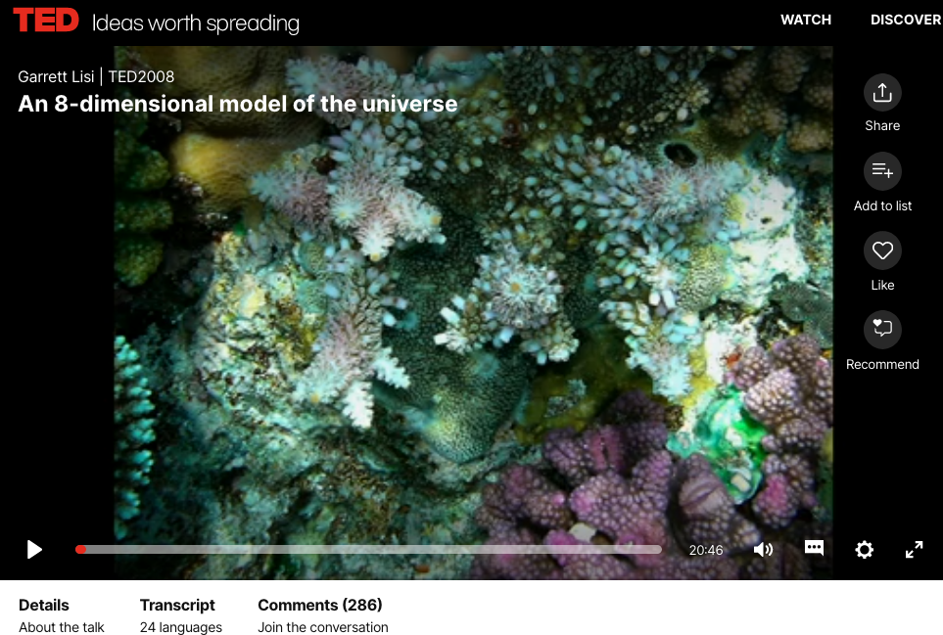
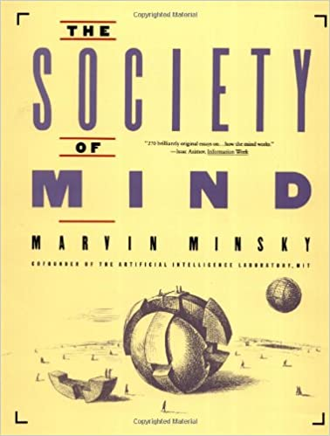
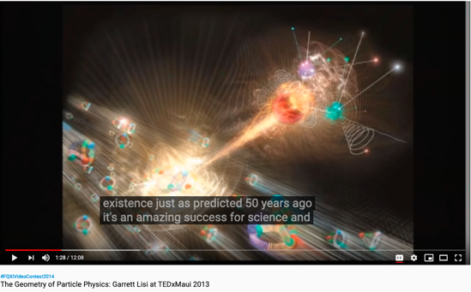
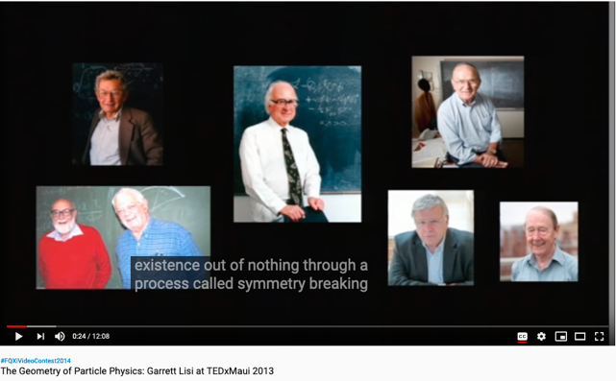
From Biology to Society of Mind
Online book: http://aurellem.org/society-of-mind/

Slide 18
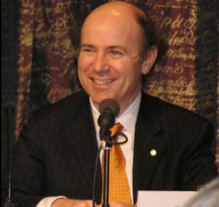
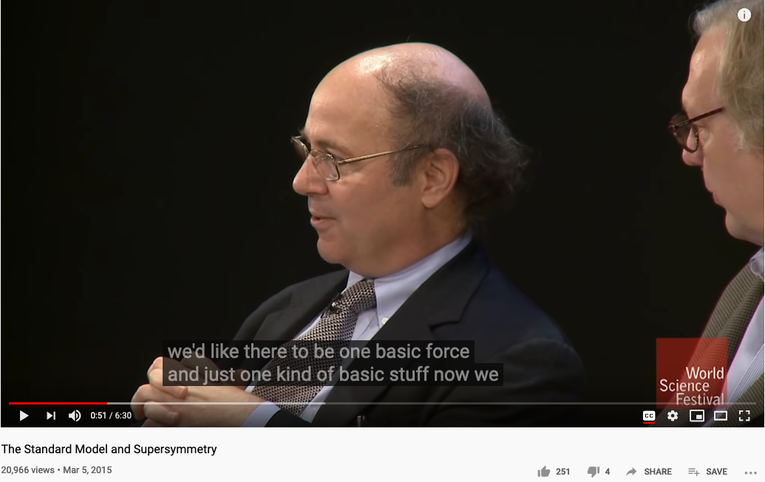
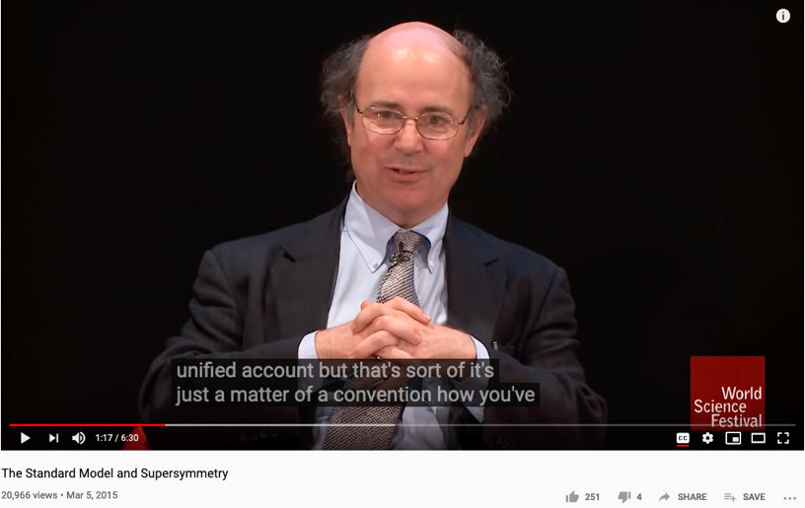
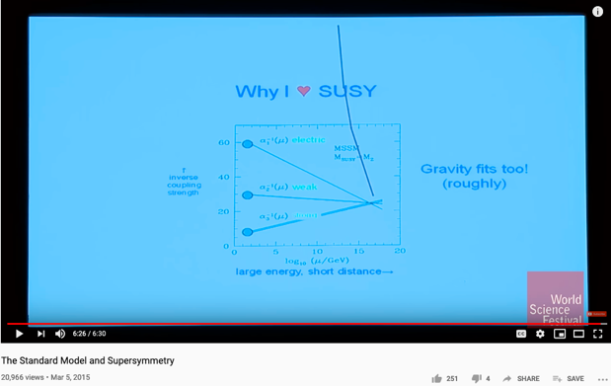
The Pursuit of a Unified Representation
Prof. Frank Wilczek of MIT, the Nobel Prize in Physics in 2004 "for the discovery of asymptotic freedom in the theory of the strong interaction."

Slide 19
Why are Names important?
A generic pool of conceptual handles for computation
Some times it is better to keep all names (terms) neutral
By assigning unique and countable names to a domain, it allows the naming systems to be reused or evolved for future use.
Many of the maturely “named” computing/logical systems are universal
They can be reused by many applications
Logical Systems have been studied extensively, and may possess desirable properties
Soundness and Completeness

Slide 20
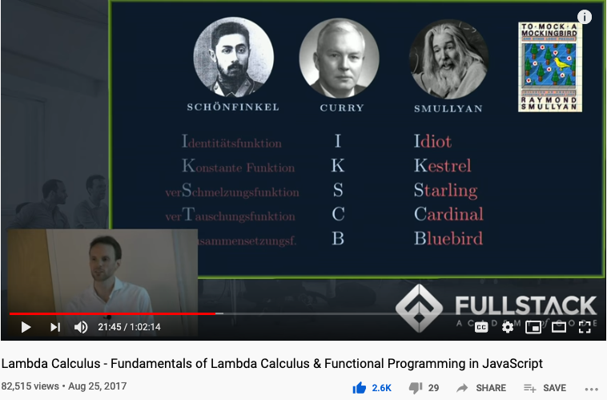
Computable Logic and Types of “Birds”

Slide 21
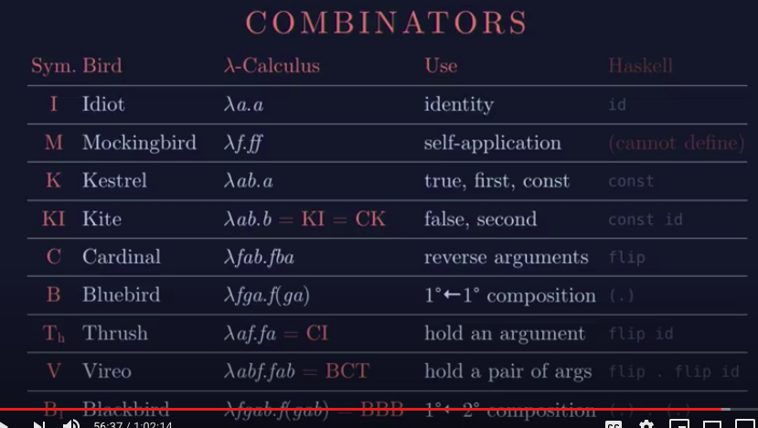
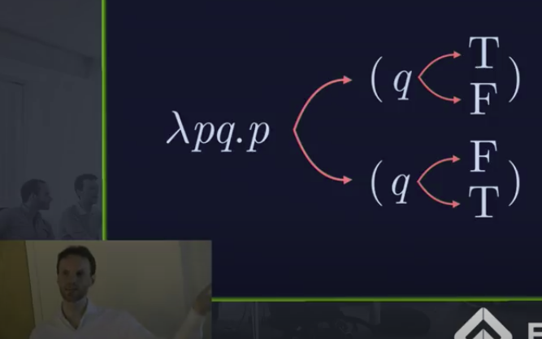
The Names of Birds (Functions)

Slide 22
Associating neutral names to ideas has utility
It is like telling mythological stories and using the names of characters to define concepts and ideas
Assigning names to ideas: using name space to compress algorithmic (temporal) complexity
Each story is a prototypical/idealized context that could be reused across many application areas

Slide 23
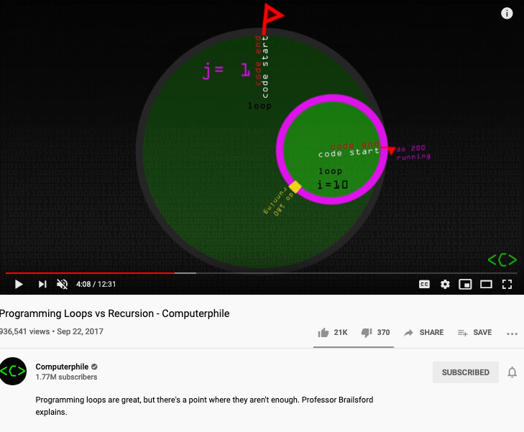

Temporal Logic: assign names to Behavioral Properties
TLA+ (Temporal Logic in Action) provides a formal language and automated mechanism to assign names in algorithmically prescribed loopy or recursive structures.

Slide 24
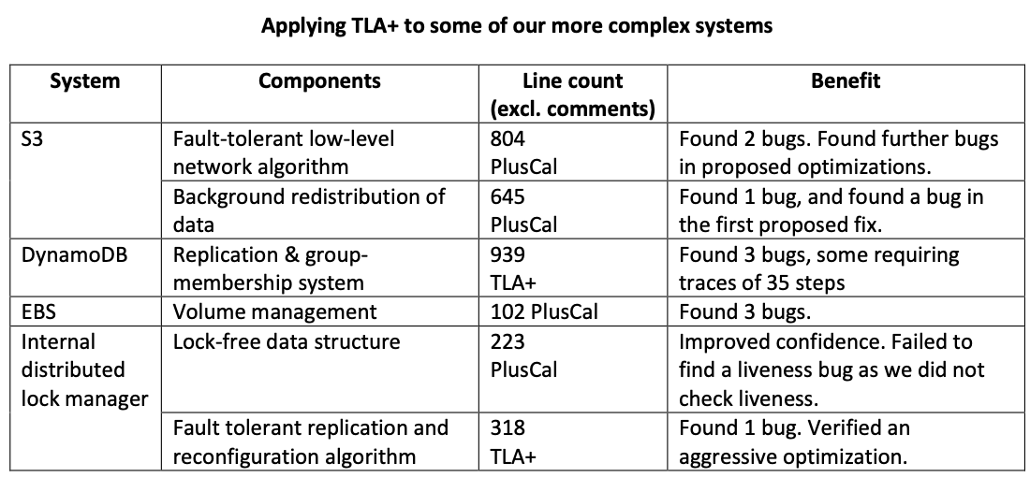
TLA+ can help analyzed System Properties

Slide 25
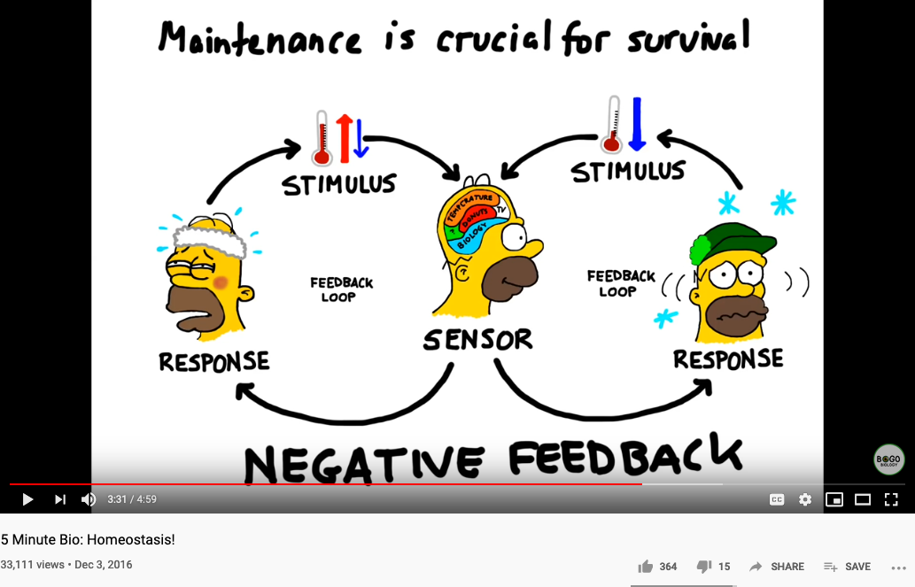
Biology and Physiology

Slide 26
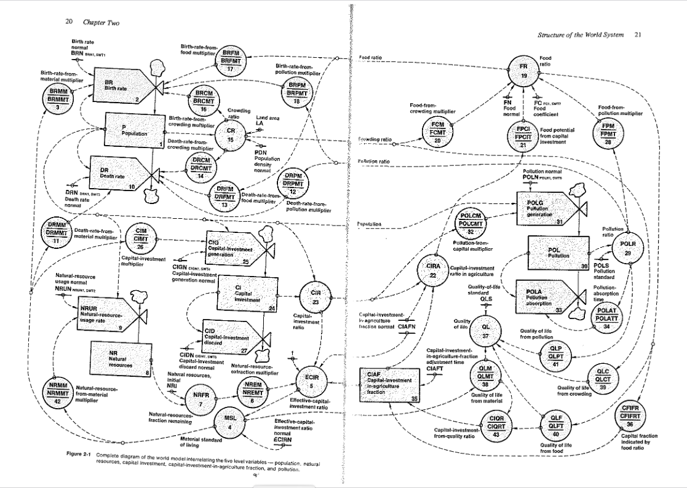
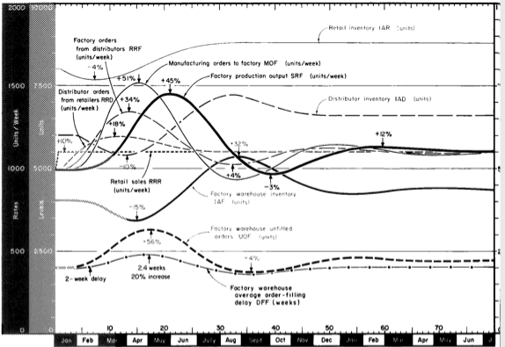
Industrial and World Dynamics
The World is made of three kinds of things:
Stock, Flow, and State variables parameterized in time

Slide 27
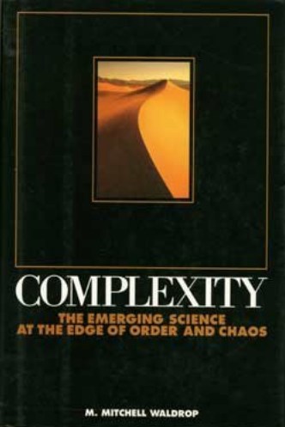
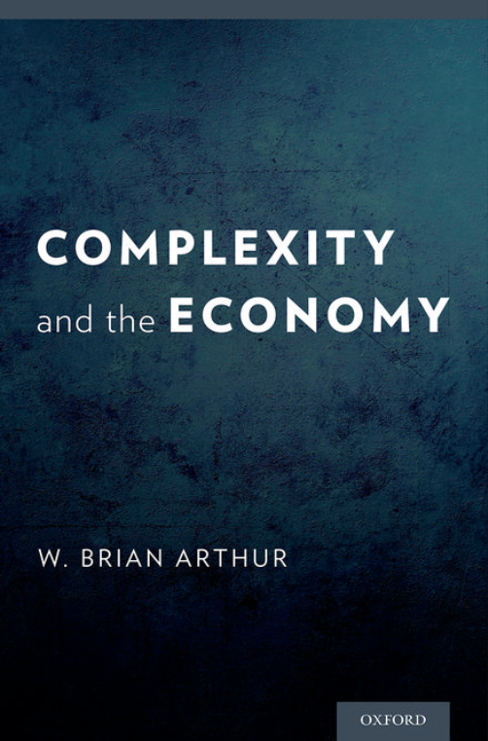
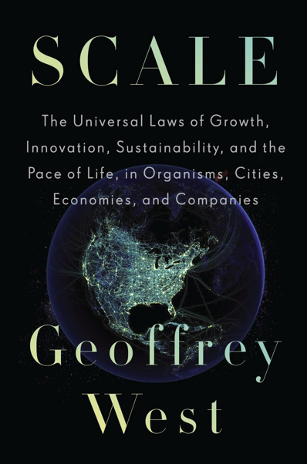
Scales: In Physical and Social Systems

Slide 28
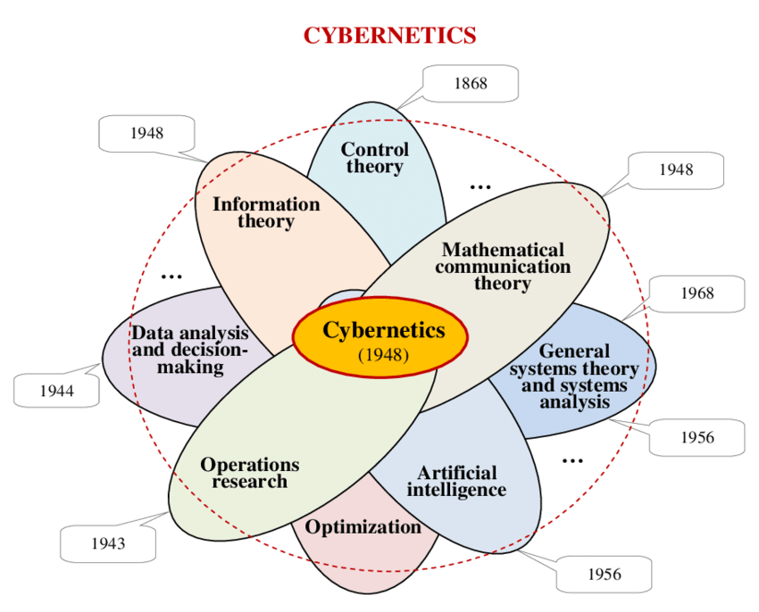
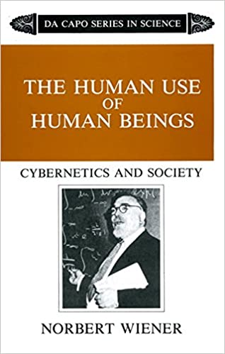
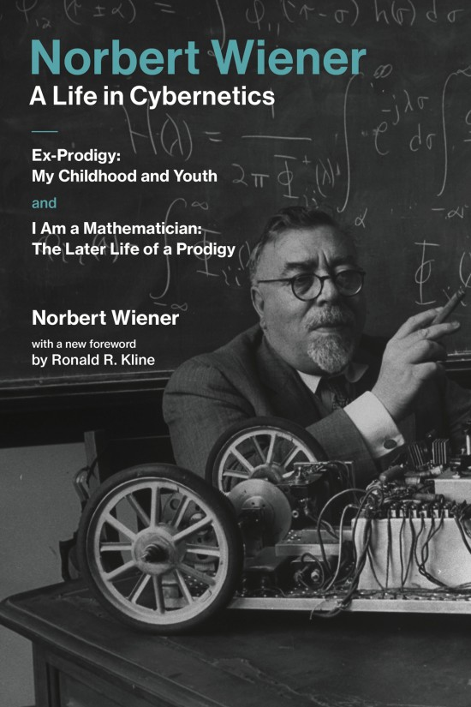
Cybernetics: Communication and Control

Slide 29
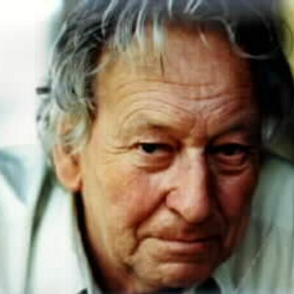
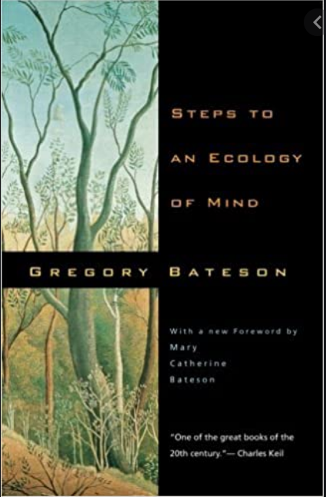
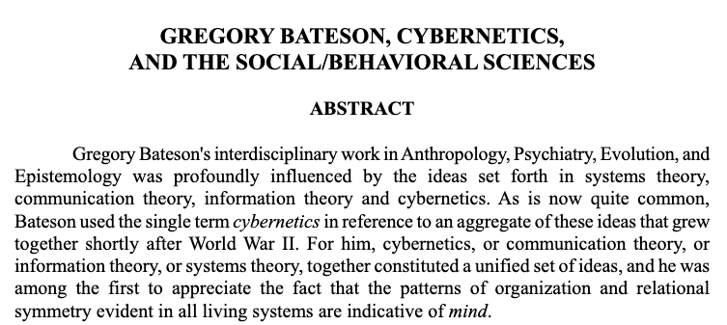

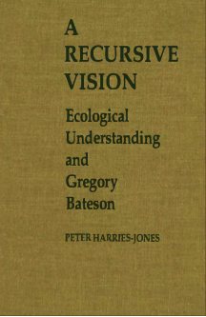
Cybernetics and the Social Behavioral Science

Slide 30
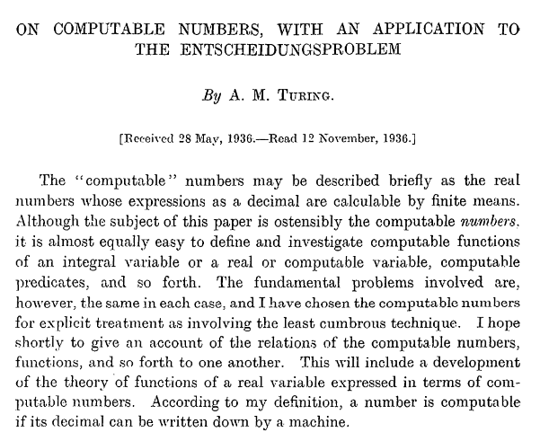
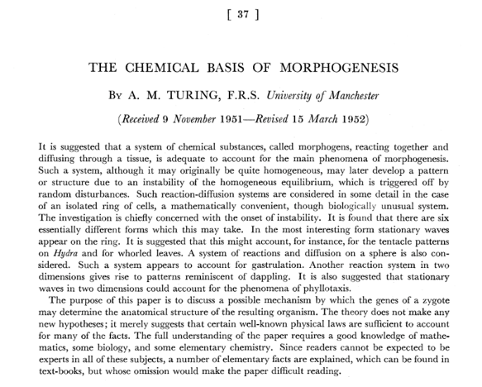
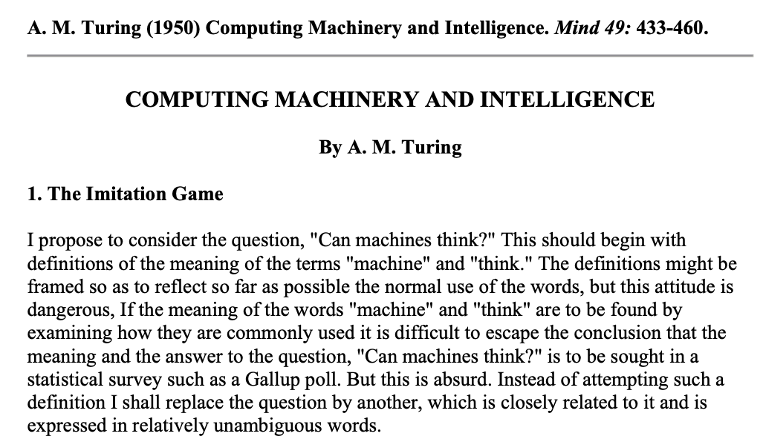
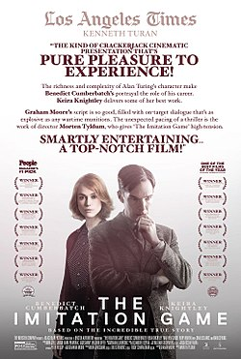
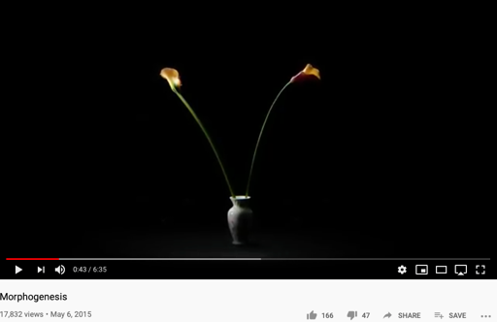
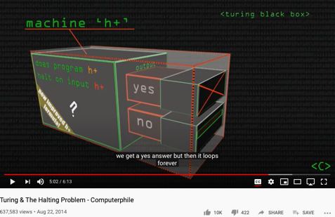
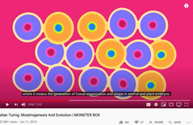
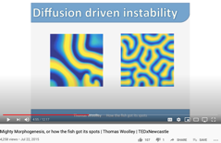
Alan Turing’s Papers
http://sitn.hms.harvard.edu/flash/2012/morphogenesis/
https://www.csee.umbc.edu/courses/471/papers/turing.pdf
https://www.mathtube.org/lecture/video/alan-turing-and-decision-problem

Slide 31

The Hierarchy of Complexity
Image Source: https://en.wikipedia.org/wiki/Turing_machine

Slide 32



An example of Automaton
The state bounds of
busy beaver
(according to Wikipedia)
Image Source: https://en.wikipedia.org/wiki/Turing_machine

Slide 33



Non-Equilibrium Thermodynamics

Slide 34




The Book of Why

Slide 35
What, How and Why
What/Association marks data content (Hyperlink in URL)
How/Intervention demonstrates active intent (human free will)
Why/Counterfactuals checks on associations by breaking symmetry
Branching on the assumptions/contextual groundings
It is the simplicity of data types (associations) that enables scale
All data types share the same basic type (association/arrow/label/named object)

Slide 36



Turing Complete Instruction Set
Paper Download Link: https://drwho.virtadpt.net/files/mov.pdf

Slide 37
The Universal Structure in 𝜆-Calculus Form
Expression := Contextualized Data (* Known interpretation results, no computation *)
| Goal_Exp Criteria_Exp (* Timeless and Time-based expressions *)
| 𝜆 Input Output_Exp(Input) (* A Computing Process *)
| ( Exception_Handling ) (* Stated boundary conditions/Exceptions *)
This set of rules can be used recursively to generate an infinite amount of expressions.
What
Contextualized data
Goal Expr
Criteria Expr
Why
𝜆
Input
Output Spec
How
( )
Exception Handling

Slide 38
Comparing 𝜆-Calculus with a Single-Instruction Machine
Contextualized data
Goal Expr
Criteria Expr
𝜆
Input
Output Spec
( )
Exception Handling

Slide 39
Use Universal Property to Generate Possible Representation
All expressions can be generated iteratively by composing content out of these four different kinds.
Contextualized data
Goal Expr
Criteria Expr
𝜆
Input
Output Spec
( )
Exception Handling

Slide 40


The Surprising Simplicity of Everything

Slide 41

What is Universality?
What is in common between Bus Arrival, Riemann Zeta Function, Chicken Retina, and Quantized Energy?

Slide 42

The Master Algorithm that will rule the world?
Bill Gates recommended this book
in 2016 Code Conference
The thesis:
Processing data through a single universal learning algorithm— can get all the knowledge from the past, the present, and the future
Pedro Domingos, TMA, P. 25
Chinese Translation
42

Slide 43

The Five Flavors of Master Algorithm
Image Source: Master Algorithm

Slide 44


Approximate Truth through Multiple Abstractions
Look into Abstract Interpretation by Patrick and Radhia Cousot
The invention of Widening and Narrowing Operators
Known in the area known as Static Analysis

Slide 45


Data Types as Lattices
Lattices are a kind of Partially Ordered Sets
Dana Scott: 1976 Turing Award
Image Source: Wikipedia

Slide 46





A Computable Language for Real Applications

Slide 47
Summary
Homeostasis comes from Feedback Loop
Non-Equilibrium Homeostasis are rare compared to the majority of matter states
Causality, Consciousness, and Statistical Correlation are hardly separable.
Data Science is Universal and Scale-Free
Applicable to Biology, Math, Physics, Society, or any Complex Systems

Slide 48
Students Actions before Monday October 5
Catching up on toyhouse.wiki:81 with all content
Use Templates for your weekly learning summary
Create a link in your personal page to your Final report page
Work with other students as a team
Assign tasks to each other
Librarian, Writer, Mediator
Pick a topic and Create an outline

